Slide 1

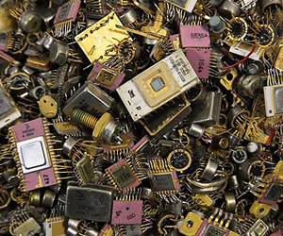
Computing Abstractions
Photo by: Steven Gerner, https://www.flickr.com/photos/
sgerner/16477700444/in/photostream/
COMP 256 – Dickinson College
Prof. Braught
Spring 2023
Image from: https://plada.com.ua/
g27814829-pererabotka-loma-othodov

Slide 2
COMP 256 in the Big Picture
Notes:
Here is the full COMP Major laid out.
Comp 256 is the foundation for the Abstractions and Systems area
We’ll learn more about what we mean by abstractions as we go along.
It is the prerequisite for any of the Abstraction Implementation courses
- Must take one for the major.
- Computer Networks
- Operating Systems
- Possibly others (e.g. Computer Architecture)

Slide 3
“The essence of abstractions is preserving information that is relevant in a given context and forgetting information that is irrelevant in that context.” John V. Guttag Introduction to Computation and Programming Using Python (Spring 2013 ed.)
* Emphasis added.
Notes:
Note this is somewhat the opposite of the common use of “Abstract”
- Abstract ideas / abstract art
- Typically perceived as harder to understand
- In computing, we use abstraction to make things easier to understand and use.
- Abstractions:
- let us focus on information (i.e. details) that are relevant
- while ignoring information (i.e. details) that are irrelevant.

Slide 4
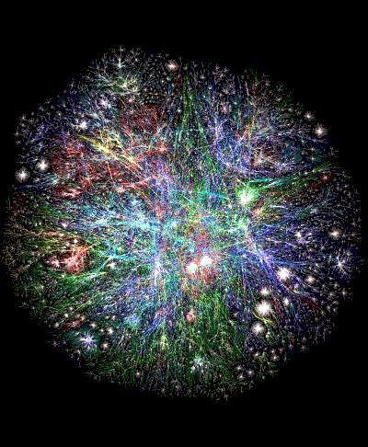
Abstraction Hierarchies in this Class
Hardware Abstractions
Data Abstractions
Machine Abstractions
Image from: https://plada.com.ua/
g27814829-pererabotka-loma-othodov
Image from: https://mse238blog.stanford.edu
/2017/08/jaydchen/five-thoughts-on-analytics-
ai-and-automation/
Image from: https://history-computer.com/
ModernComputer/Electronic/Colossus.html
Operating Systems
Abstractions
Language Abstractions
Networking Abstractions
Web Abstractions
Image from: https://www.archer.eu/blog/what-makes-functional-programming-a-viable-choice-
for-artificial-intelligence-projects/
Image from: https://www.mychoicesoftware.com/
blogs/news/why-do-so-many-companies-use-
windows-os
Image from: https://dealna.com/Article/
Post/6564/Networking-Accessories
Image from: https://vistapointe.net/
web-world-map.html
Notes:
Keep it short.
Going to look at how abstraction let us produce complex things in a variety of areas…
How to build computations and memories out of transistors
How to represent data with 0’s and 1’s
How to organize computations and memories into computers
How to get HLL programs (Java/Python) to run on a machine that responds only to 0’s and 1’s
How does an OS make your machine easier/better to use
How does data get transferred over a network.
How do web applications work

Slide 5



The Philosophical: Breadth of Topics / Narrow Depth
Images from: openclipart.org
Notes:
Topics are like lakes
- Broad big picture
- to lay foundation in a variety of important areas of computer science.
- preparation for a wide range of different futures.
Depth is like dropping a stone in and following it down.
- help us to
- understand abstractions and hierarchies by looking at them at multiple levels.
- develop intuition about how things are built and how they work.
- use and learn new technologies, languages, frameworks, tools
There is depth everywhere in these lakes
- but we will look only at a narrow path through the layers of abstraction for each topic in this class.
- All of these topics can have a full course organization, architecture, operating systems, networking, web-development
Goal is not to make you a hardware engineer, or an assembly language programmer or a web developer
But to give you insights and an intuition into how these things work
That will give you a foundation to connect to when you learn more about those that are ultimately relevant to you.

Slide 6
Why Computing Abstractions
Breadth of preparation for a wide range of possible futures.
Hardware, languages, operating systems, networks, web development
Understanding how things work builds intuition for:
Learning new abstractions
Creating new abstractions
Debugging across levels of abstraction
Sometimes, what looks like a bug at one level can only be understood by looking at a lower level of abstraction.

Slide 7
“In the development of the understanding of complex phenomena, the most powerful tool available to the human intellect is abstraction.” C. Antony “Tony” R. Hoare Notes on Data Structuring (1972)
Notes:
Pretty heady stuff.
But true… without abstraction nothing we do as computer scientists would be possible.
Hoare
- Computer Science Pioneer
- Turing award winner for “For his fundamental contributions to the definition and design of programming languages.”
- Nobel Prize of Computer Science
- Invented QuickSort
- Invented null reference – and it’s said he regretted it ever since.

Slide 8


Acknowledgments
Slide Template From:
https://creativecommons.org/licenses/by/4.0/
Slide Content Licensed as:
Creative Commons Attribution-NonCommercial-ShareAlike 4.0 International License.
Notes:
Note: Individual images may be covered by their own licensing agreements and were incorporated here under fair use. Their use in this slide deck does not change or alter their licensing.

